Slide 1
Sanketh
tumul
Gene Cloning

Slide 2
DNA CLONING
A method for identifying and purifying a particular DNA fragment (clone) of interest from a complex mixture of DNA fragments, and then producing large numbers of the fragment (clone) of interest.

Slide 3
Why Clone DNA?
A particular gene can be isolated and its nucleotide sequence determined
Control sequences of DNA can be identified & analyzed
Protein/enzyme/RNA function can be investigated
Mutations can be identified, e.g. gene defects related to specific diseases
Organisms can be ‘engineered’ for specific purposes, e.g. insulin production, insect resistance, etc.

Slide 4
Why synthesize human insulin?
Patients’ immune systems do not produce antibodies against human insulin as they do with bovine or porcine insulin
Projected decline in the production of animal-derived insulin
Need for a more reliable and sustainable method of obtaining the product

Slide 5
Cloning - a definition
An individual grown from a single somatic cell of its parent & genetically identical to it
Clone: a collection of molecules or cells, all identical to an original molecule or cell

Slide 6
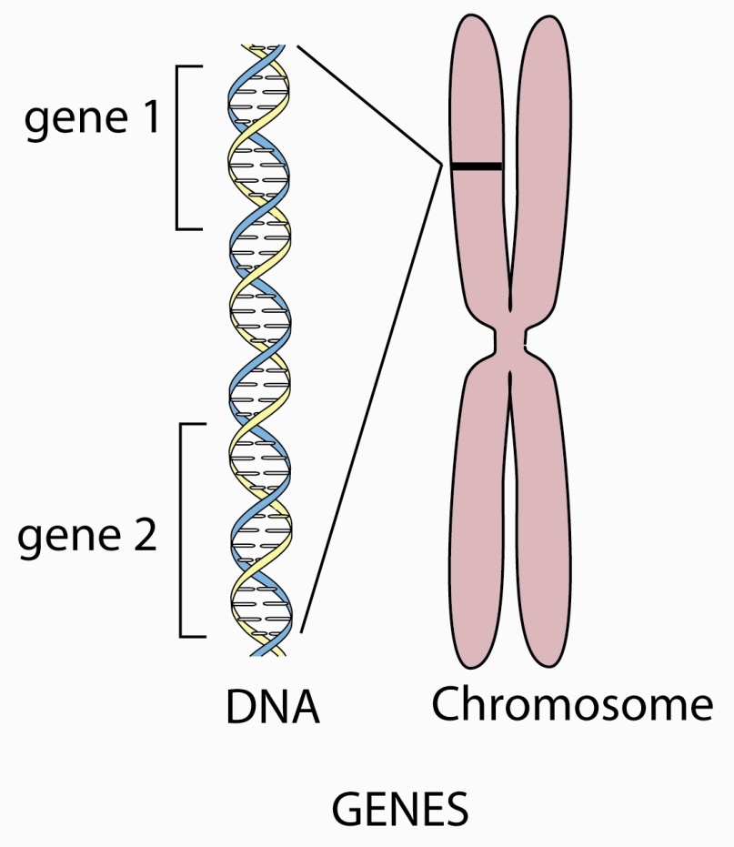
Gene cloning
When DNA is extracted from an organism, all its genes are obtained
In gene (DNA) cloning a particular gene is copied (cloned)

Slide 7
Sources of DNA for Cloning
1) Chromosomal DNA
2) RNA converted to cDNA
3) PCR-amplified DNA

Slide 8
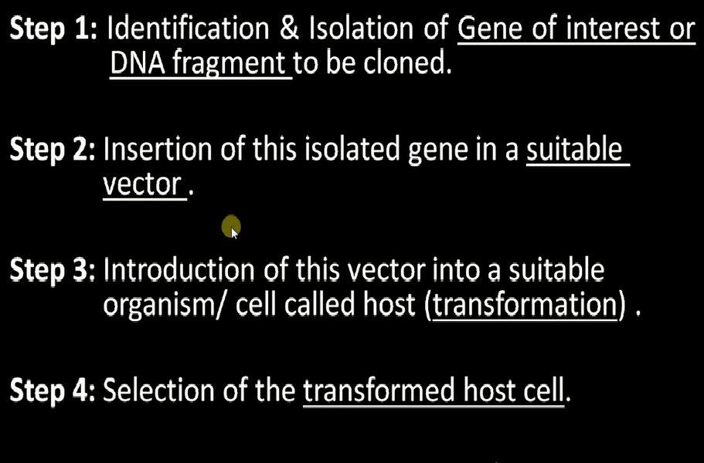

STEPS IN CLONING

Slide 9
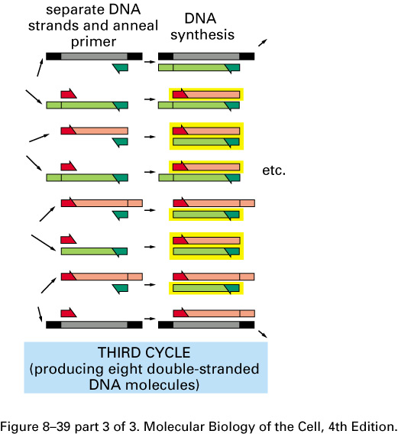
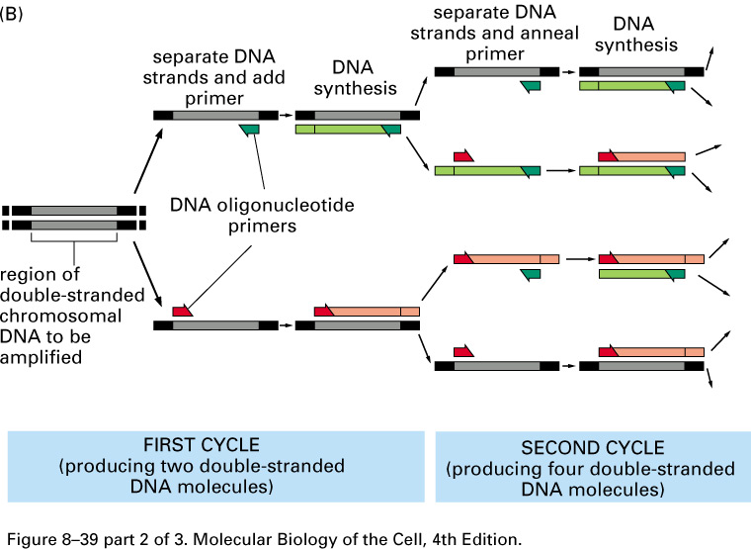
PCR-amplified DNA

Slide 10
Cloning Tools
Restriction endonucleases
Ligase
Vectors
Host
Methods for introducing DNA into a host cell

Slide 11
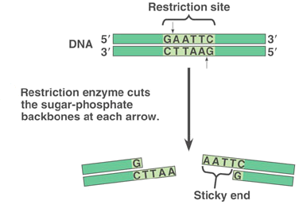
Cutting DNA
Restriction endonucleases (restriction enzymes)
  sticky ends
  blunt ends
Nomenclature
  EcoRI
  E = genus (Escherichia)
  co = species (coli)
  R = strain
  I = # of enzyme

Slide 12
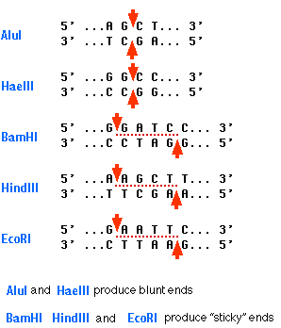
Blunt & Sticky ends

Slide 13
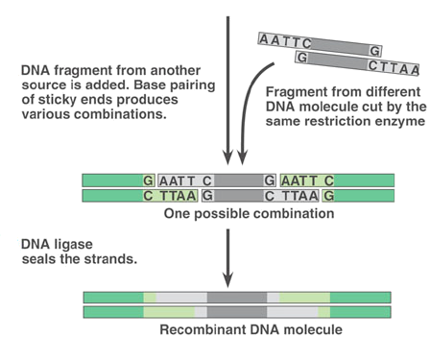
Pasting DNA
Complementary ends (sticky ends) H-bond
Ligase forms phosphodiester bond to seal strands together.

Slide 14
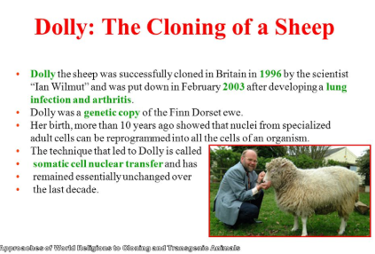

Slide 15
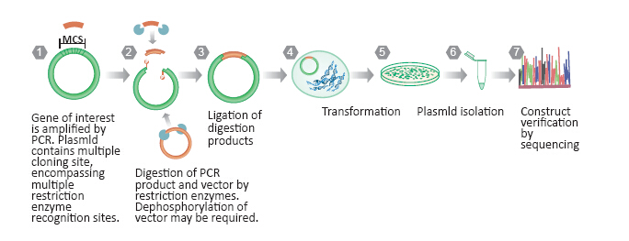

Slide 16
Why synthesize human insulin?
Patients’ immune systems do not produce antibodies against human insulin as they do with bovine or porcine insulin
Projected decline in the production of animal-derived insulin
Need for a more reliable and sustainable method of obtaining the product

Slide 17
